Slide 1
Stock Price Prediction forecast for Amazon
Up to 30 days
(Group 3)

Slide 2
Mentor’s Name:
Aishwarya Ajay Mate
Team Mates Name (Group 3):
Mr. Shubham Malik
Miss. Gayatri Sunil Wagh
Mr. Atharva Nilesh More
Mr. Prasad Uday Mayekar
Mr. Bharath A G
Hemarani A N
Keerthi M

Slide 3
Objective:
The objective of the "Stock Price Prediction Forecasting" project is to utilize web scraping to gather stock data and then employ Python-based time series analysis techniques to develop accurate predictive models. This project aims to enhance understanding and prediction of stock price movements, aiding investors in making informed decisions.
Problem Statement:
Developing a forecasting model for stock data to predict future price movements and trends accurately, while considering the inherent volatility and unpredictability of financial markets

Slide 4
Exploratory data Analysis:
Data cleaning is the most important part of any analysis. So different libraries were used to perform the task. We looked for the following things:
Missing values
Outliers
Duplicated values
Invalid errors
Because the data which we extracted was from yahoo finance, so there was not much cleaning required for the data.
Other than that, we looked at the statistical data related to the data using functions like “info()”, “describe().”

Slide 5
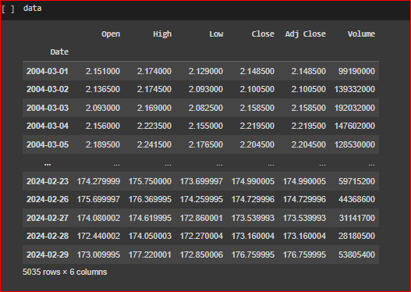
Data: (We are going to use the ‘Close’ column for model building and date column for index)

Slide 6
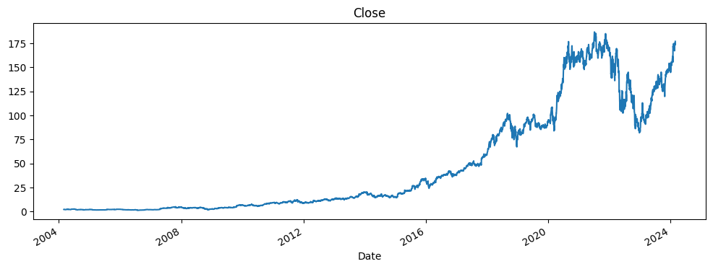
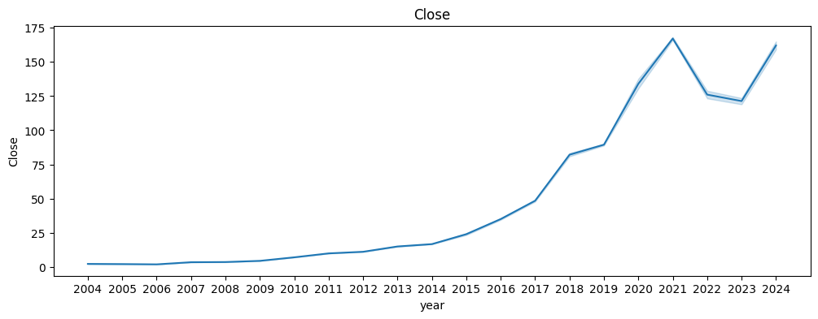

Slide 7
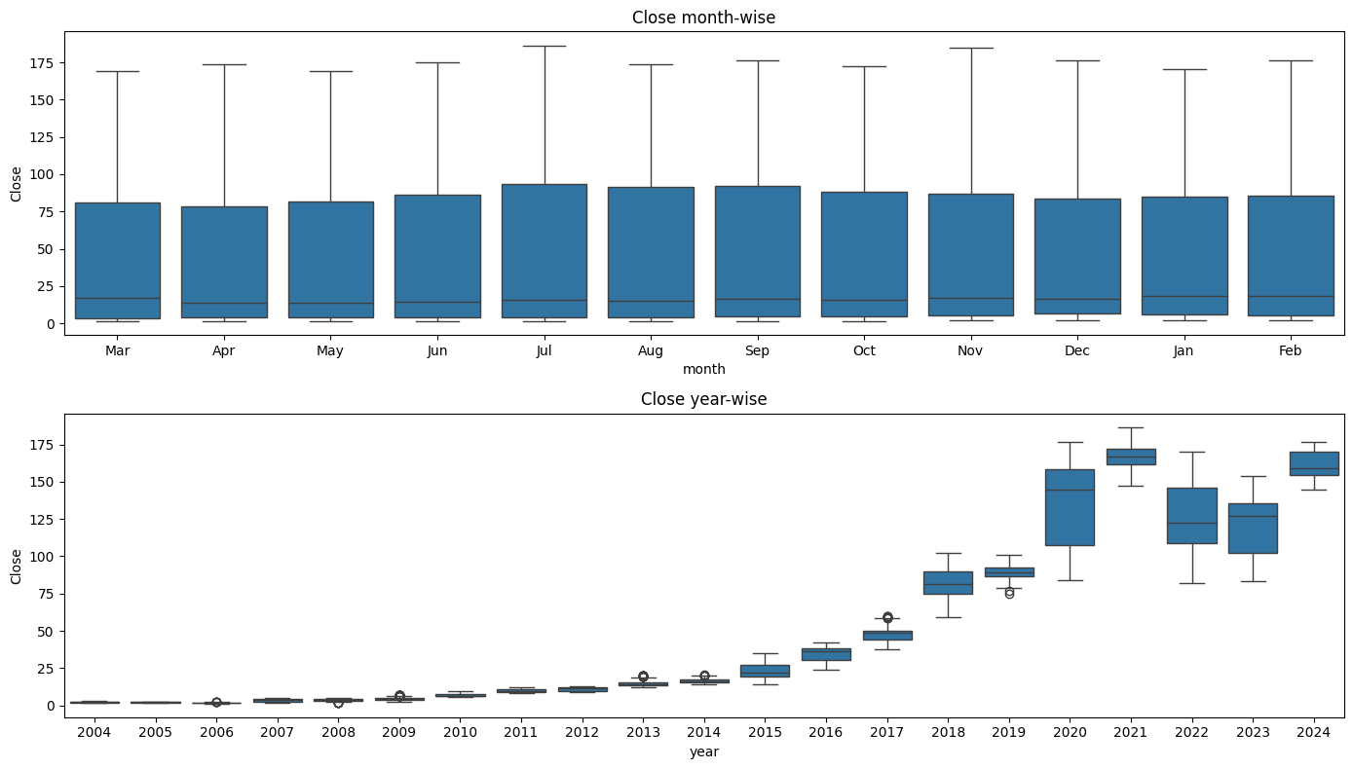

Slide 8
Conclusion drawn from the graphs
Clearly, the prices reached the highest point in 2021. But there is a downfall in the prices after that.
If we look closely, we can see two important things.
We can see the slope of the graphs increasing sharply after 2019. And for the graph between 2019 to 2021, the graph slope is maximum. This was the time period when outbreak of COVID-19 had disrupted the world. And all of us were confined within the bounds of our houses. And therefore, online shopping took became a thing of day-today life.
But in February 2022, Russia-Ukraine war started and that disturbed the whole supply chain. And hence we can see a sharp decrease from 2021 to 2022.
Here we can see an upward trend in 2024, but we cannot say anything about it, because we still have just two months' data, though things are settling back in again, we can expect it to follow the upward trend. But the bottom line is it could go in either direction.
Also, the variation, within the year is highest for 2020, and likewise there is also considerable variation in the years 2022 and 2023. So, we hope it is safe to say that the years affected by the major external events, which had world wide impact, saw the major variation in prices.

Slide 9
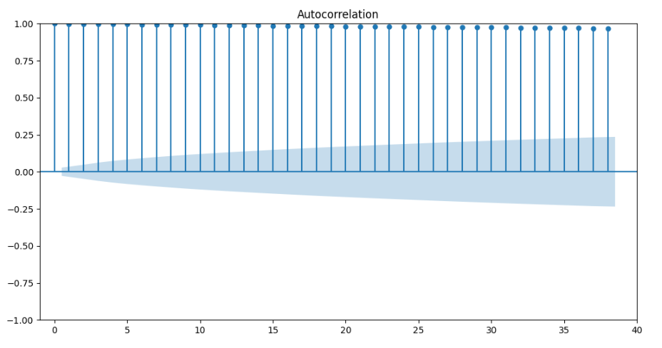
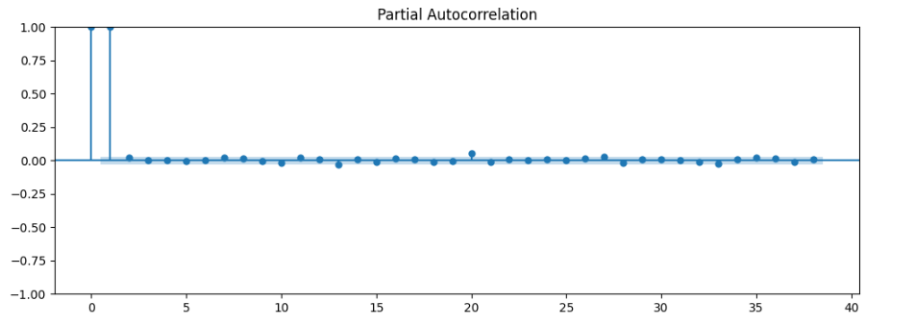
ACF and PACF plot
The ACF plot gives the suitable value for moving average lag window. Here, we can see that 39 is the appropriate number. (The number is determined by the count of the bar which are extending outside the limits of higher and lower bound).
The PACF plot gives the appropriate value for order of the Auto-regression model. And here the appropriate value is 2.

Slide 10
Feature engineering
Resampling and interpolation: Because the data was not available for Saturday and Sunday, so we had to resample the data and the interpolate it using linear interpolation.
Transformations: We explored various transformations like, square root transformation, log transformation, boxcox transformation, to get a stationary data.

Slide 11
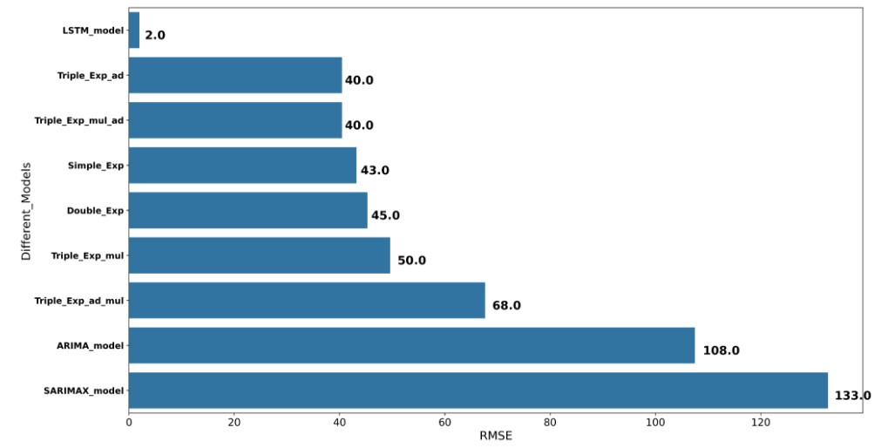
Model used and there results

Slide 12
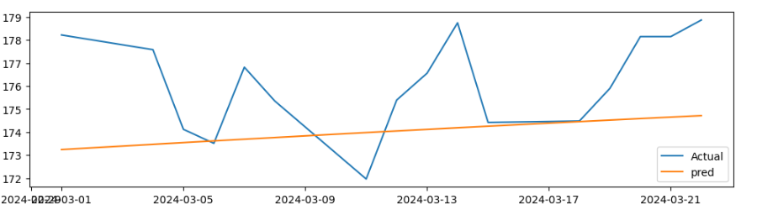
LSTM model and it’s prediction
Comparison with the March’s Data

Slide 13
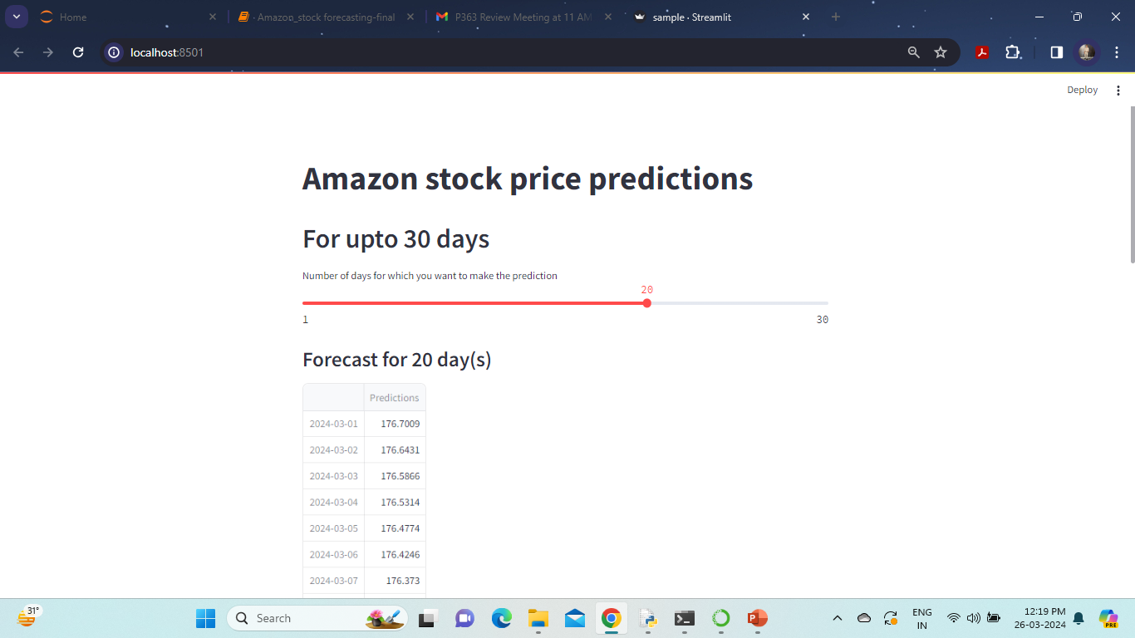
Deployment Web Page

Slide 14
Challenges faced:
Major challenge faced was during the model building, where we were struggling to get model with low RMSE value. Which was finally resolved when we explored LSTM model.
Another challenge was with the forecasting using the LSTM model. We couldn’t figure out at first how we are going to perform it. Then we worked our way through it, and came up with the iterative method to get the predictions.
The final challenge was when we couldn’t perform the deployment. With not enough experience of using streamlit, it came up as a challenge to get the web deployment done. But with the collaborated efforts and discussions we were able to get it done by the end!

Slide 15
Thank you

